Slide 1
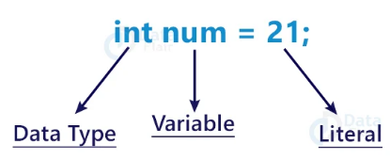

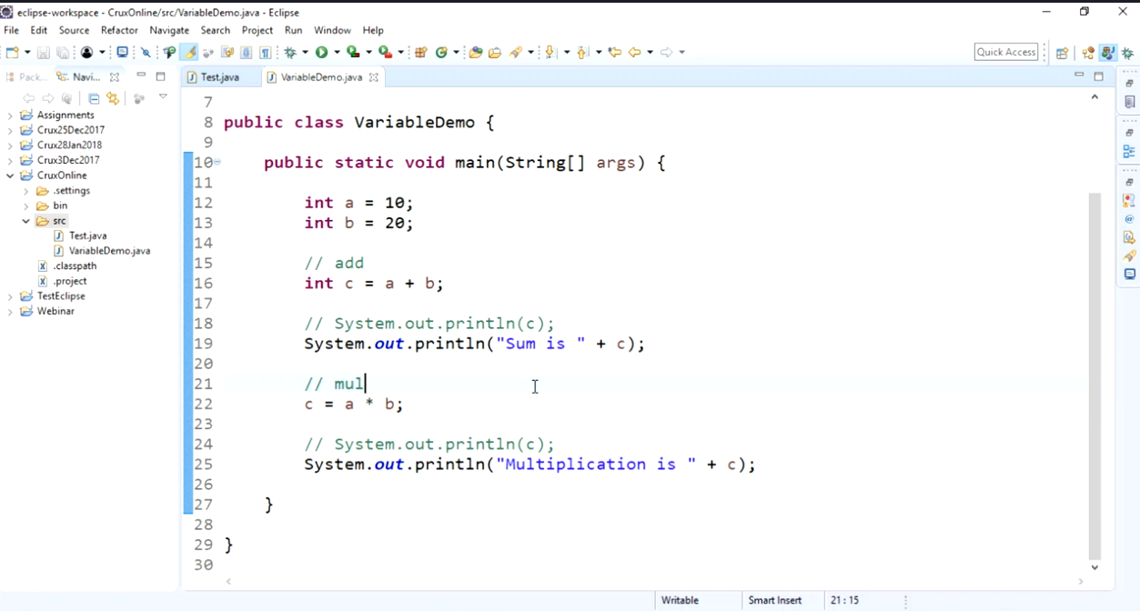
This is a compile time error

Slide 2
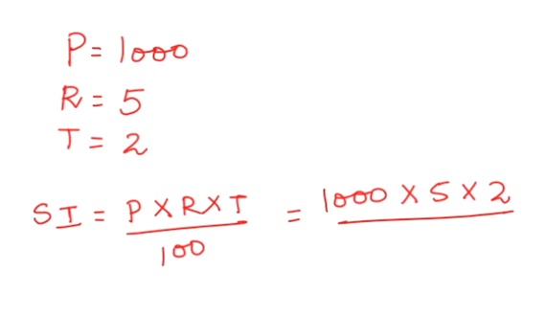
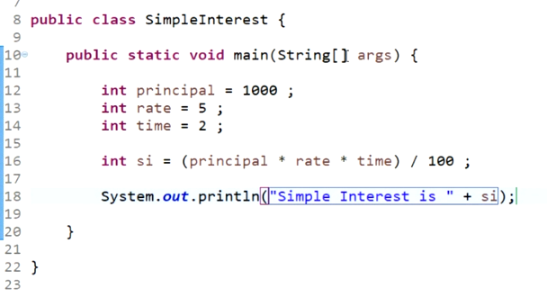
Simple interest

Slide 3
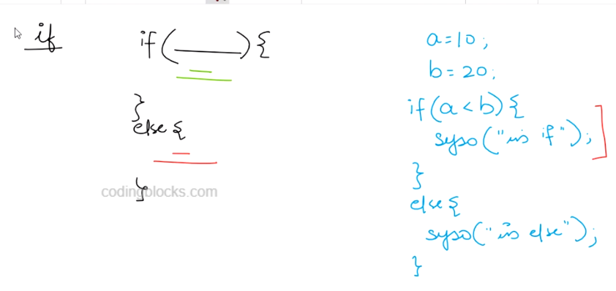
If-else
If condition for if is satisfied it will never go to else block and vice-versa
* If you want to run tests for many conditions and in whichever case the condition is true that condition should be implemented…. And one condition is not complimentary of the remaining the use if ….if… if…

Slide 4
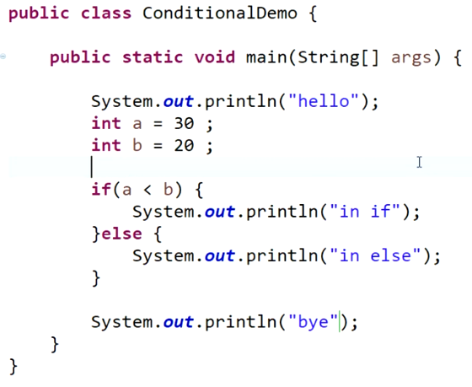

Slide 5
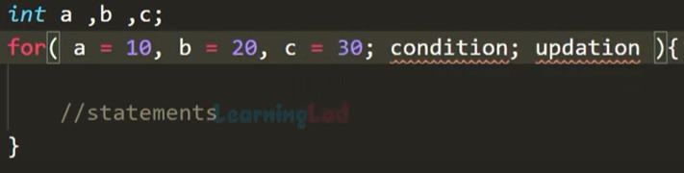
For loop flow
(Itteration 1)
1. Initialisation (only once)
2. condition
3. All statements inside the for loop will be executed4.
updation(Itteration 2)
1. condition
2. All statements inside the for loop will be executed3. updation

Slide 6
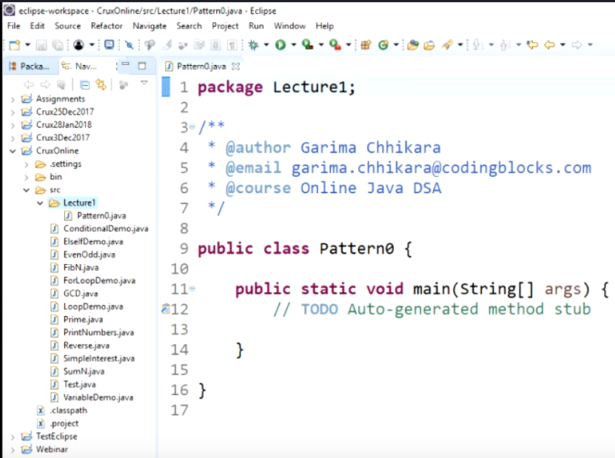
Package

